Slide 1
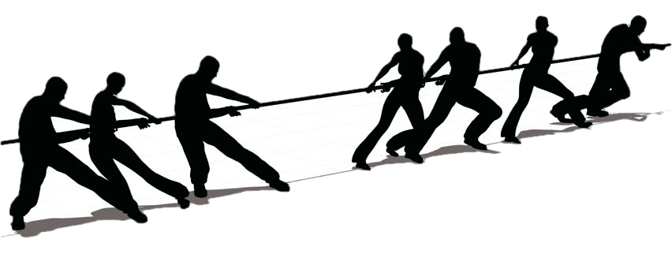
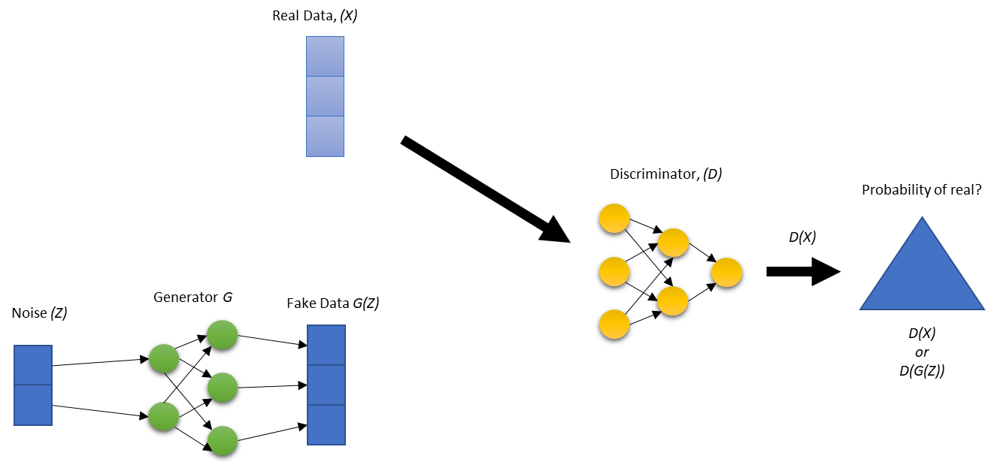
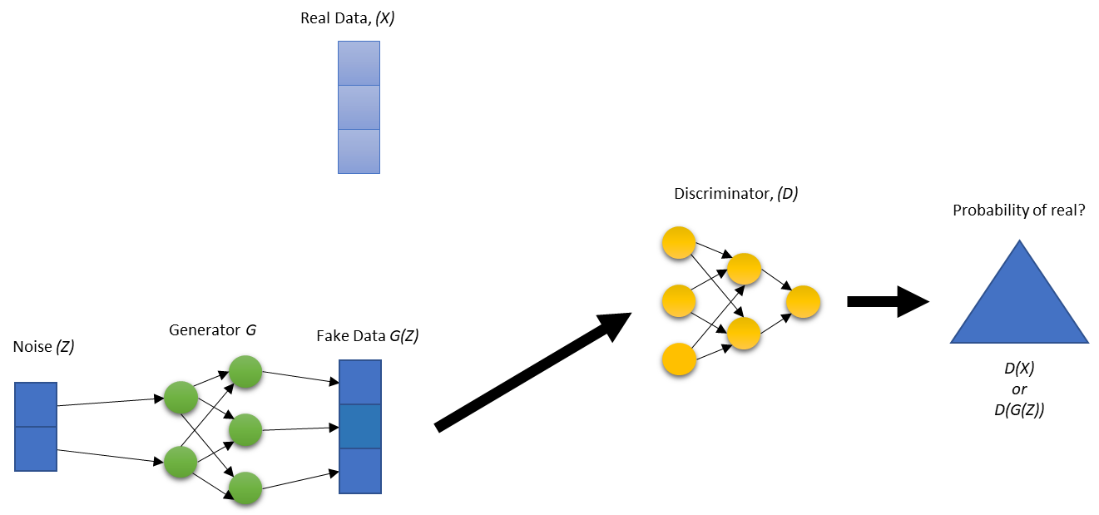
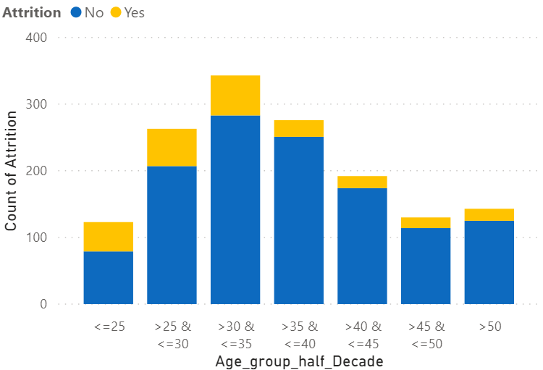
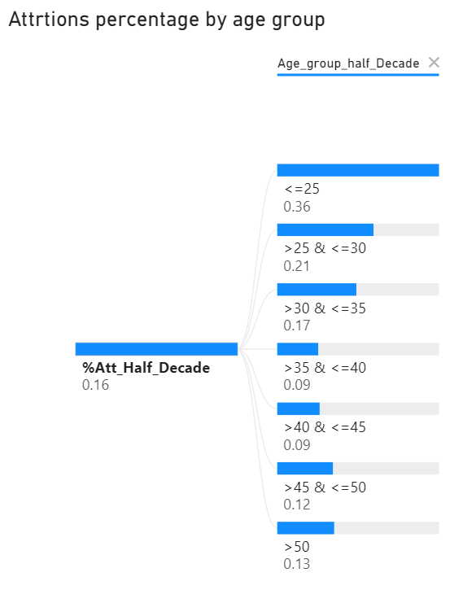
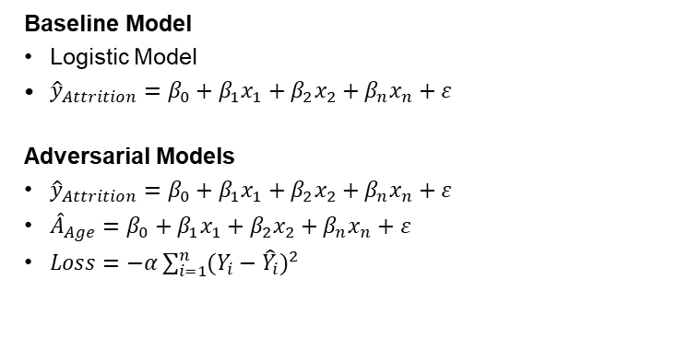

Bias in Machine Learning: An Adversarial Approach
Solange Garcia de Alford, Steven Hayden, Nicole Wittlin
Master of Science in Data Science
Southern Methodist University, Dallas, TX 75275, USA
Introduction
Model Architecture
History of Bias and Fairness in ML
Most Studies use Binary / Protected – Unprotected
Another Point
What else do we want to say for Intro?
Baseline Model
Logistic Model
${\hat{y}}_{Attrition}=β_{0}+{β_{1}x}_{1}+{β_{2}x}_{2}+{β_{n}x}_{n}+ε$
Adversarial Models
${\hat{y}}_{Attrition}=β_{0}+{β_{1}x}_{1}+{β_{2}x}_{2}+{β_{n}x}_{n}+ε$
${\hat{A}}_{Age}=β_{0}+{β_{1}x}_{1}+{β_{2}x}_{2}+{β_{n}x}_{n}+ε$
$Loss=−α\sum_{i=1}^{n}{{(Y_{i}−{\hat{Y}}_{i})}^{2}}$
Note:
Include something about loss f()
Main Topics
While your poster follows your paper, it does not have to have the same sectioned titles
Your poster has main topics, but does not typically contain a “related work” section
Your results look good as figures and tables intermixed into the center column
Few more statements
What else to day
Results
Improved Demographic Parity: Explain this here, what does this mean
Small trade-off between Accuracy and Fairness Post-GAN: explain this here, show decline
What else: should go here, blah blah blah
See Results Chart
Data Overview
ACCUR | < = 25 | (25, 30] | (30, 35] | (35, 40] | (40, 45] | (45, 50] | > 50 | Overall
Pre GAN
Post GAN
Conclusions
IBM Employee Attrition Dataset
Other Comment, Counts
Another Statement Will Fit
This is not a very good story.
Your goal is to make this pretty and informative.
Tell your story and break some eggs, but just make sure you have accomplished the task of a poster.
Blah blah blah
People matter
Don’t be jerks, have feelings
Etc
Etc
Etc
Etc
DEMO PARITY | < = 25 | (25, 30] | (30, 35] | (35, 40] | (40, 45] | (45, 50] | > 50 | Overall
Pre GAN
Post GAN

